Slide 1

POVERTY AND HUNGER Submitted By: Vaibhav Kumar Registration Number : 11811376 In partial fulfillment for the requirements of the award of the degree of “ B.Tech - CSE (Hons.) ” School of Computer Science Engineering Lovely Professional University Phagwara, Punjab

Slide 2
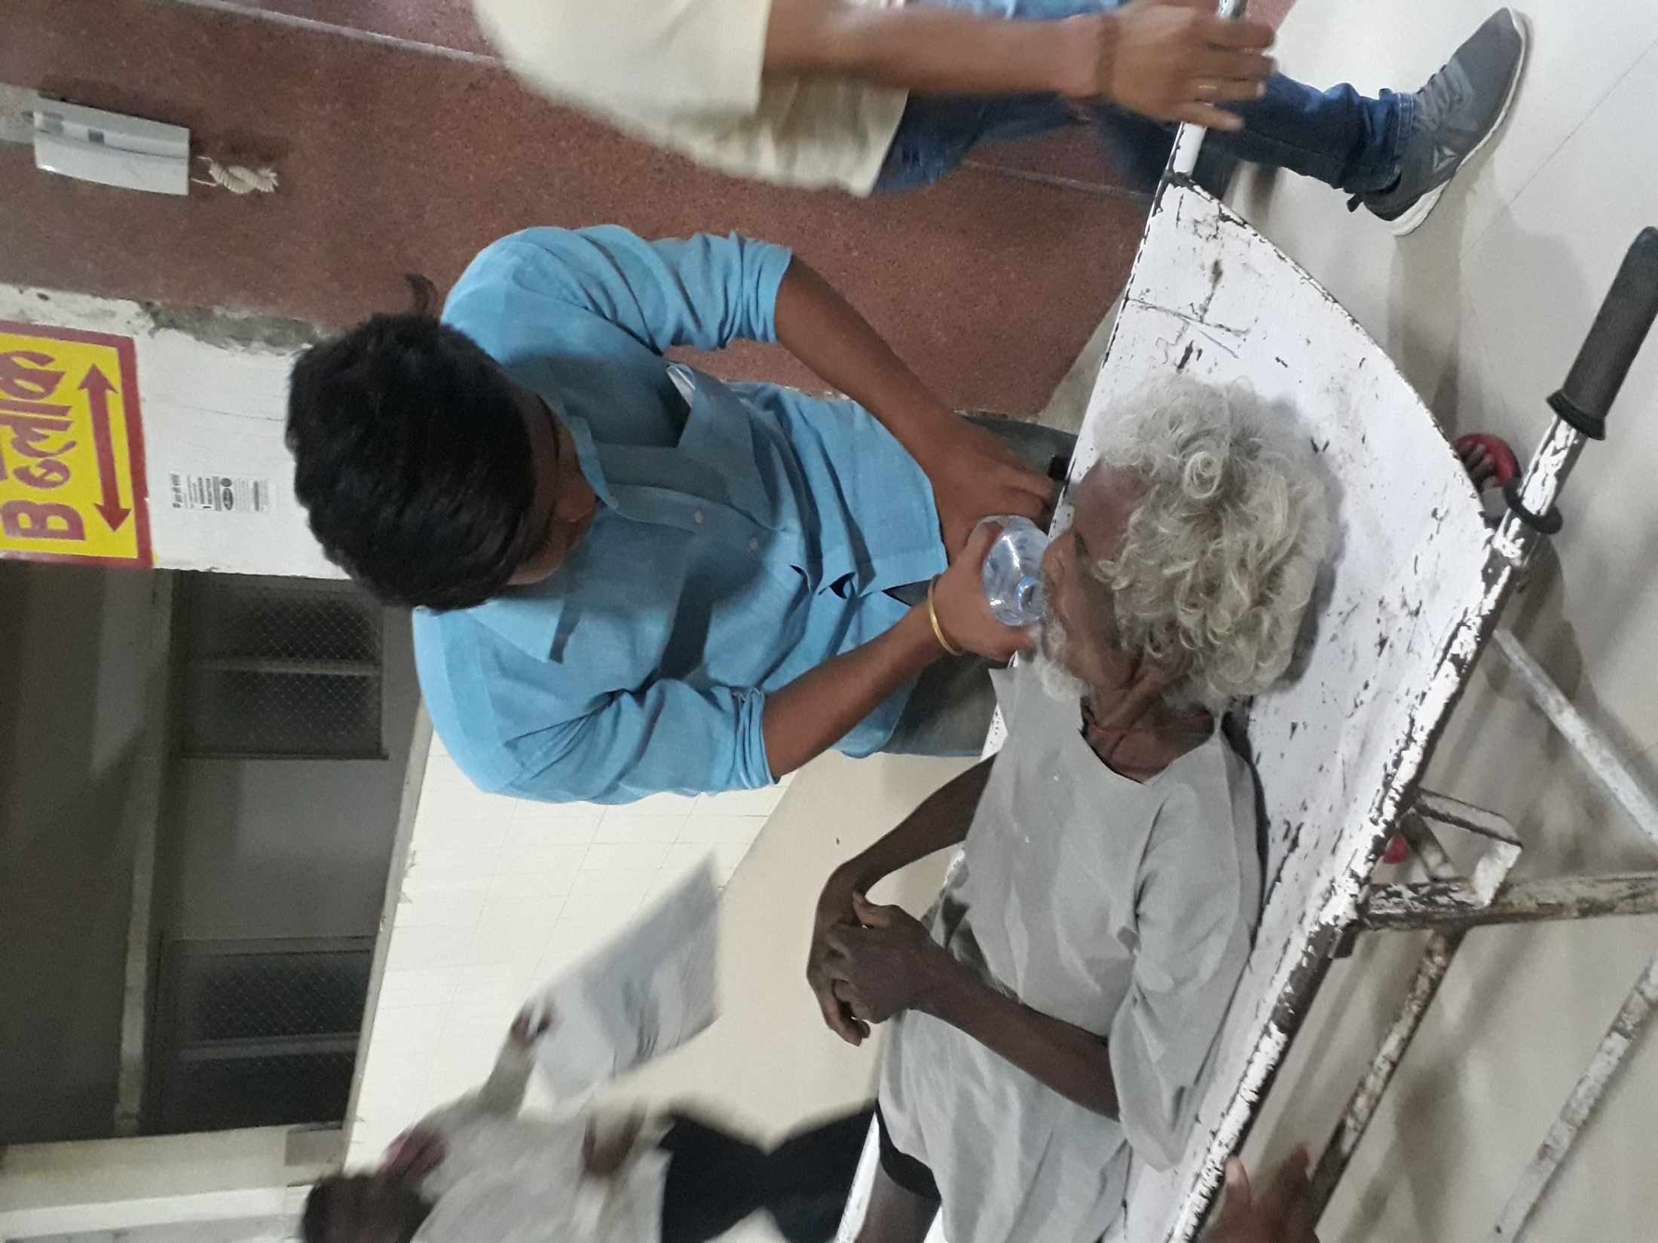
POVERTY AND HUNGER

Slide 3

Index
Introduction
Problem indentified and cause
Objective to be achieved
Steps taken to achieve the objective
Effectiveness of the project
Conclusion
Photographs

Slide 4
Introduction
Poverty: Inability to afford basic human needs which commonly includes “clean fresh water, nutrition, healthcare, education, clothing and shelter.
Hunger:
A condition in which a person, for a sustained period, is unable to eat sufficient food to meet basic nutritional needs.

Slide 5

Poverty and Hunger
Are easily assumed as head and tail of a coin, because, they cannot be separated from each other.

Slide 6
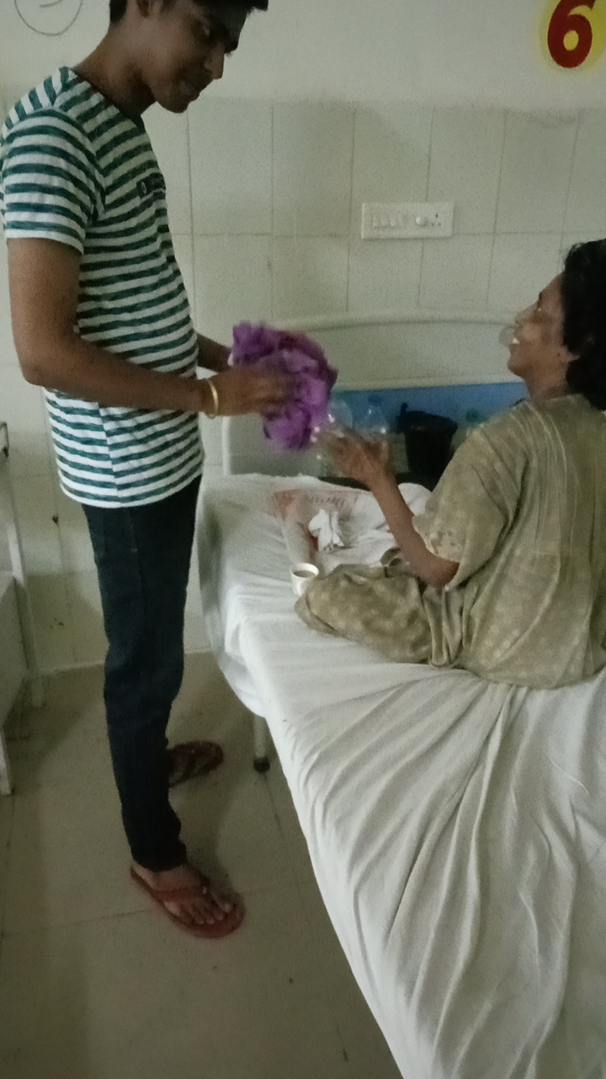
Poverty and Hunger is a universal problem, which is drastically affecting our world and ultimately resulting to death, from many years to present.

Slide 7
Problem indentified and cause
Lack of shelter
Lack of education
Lack of food
Bad government policies
Not having good health
Farmers are unaware about modern farming method

Slide 8
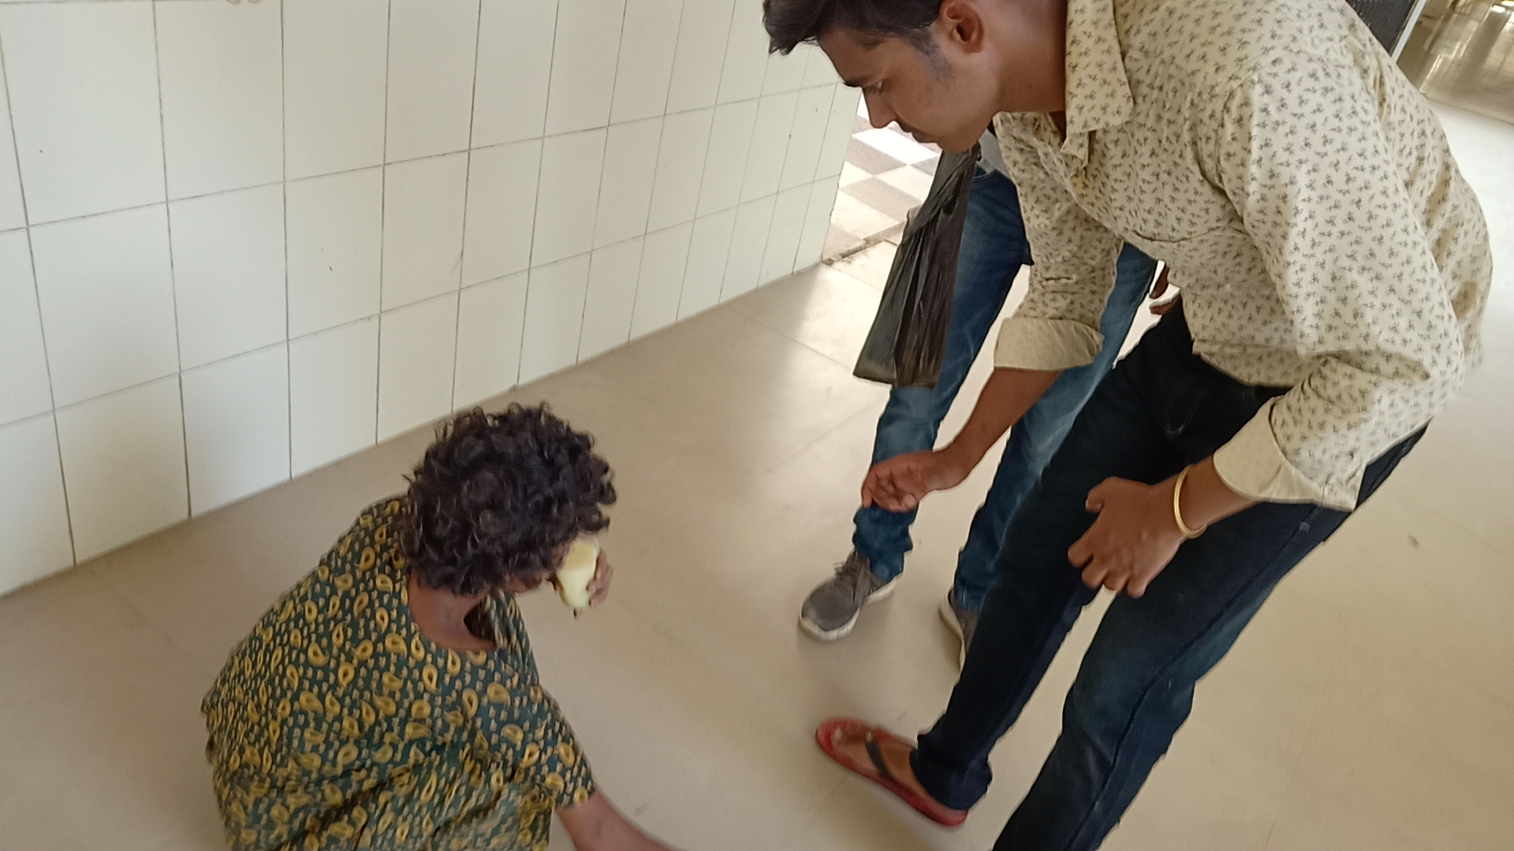
Rise in cost of living, making poor people less able to afford items.
Lack of individual responsibility and hard working nature.

Slide 9
Objective to be achieved
Educating to poor children and generating more employment
To aware the farmers about modern farming method.
To help orphan people suffering from hunger by serving them free food.

Slide 10
Steps taken to achieve the objectives
Convincing parents to send their children to school
Selection of the targeted people/ student.
Gaining the support of gram pradhan.
Convincing the farmers to gather at a single place.
Donating clothes and serving food to people, who suffer from poverty and hunger

Slide 11
Effectiveness of the project
Chance for releasing my own responsibilities towards the people and community
The children started attending classes regularly with a keen interest
People got to knew about the scarcity of the food face these days.
Many people get inspired by my work and joined me in helping the poor's.

Slide 12
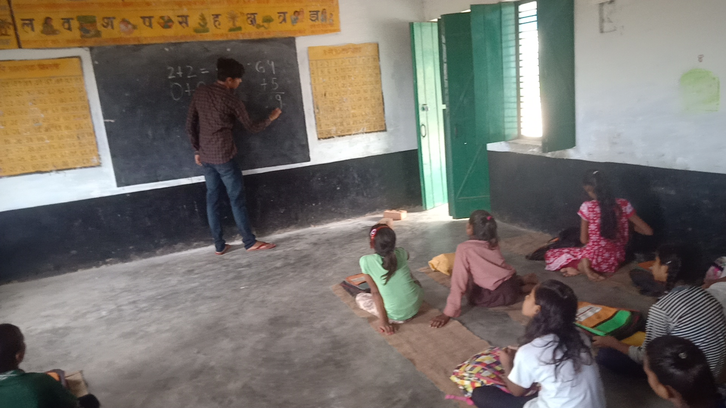
Farmers agreed at point of using new machinery and chemical
As I was alone in this project the results were not noticeable on a larger scale though there was a huge level up in the understanding of the social responsibilities

Slide 13
Conclusion
In my opinion, poverty is the main reason for hunger, whether is it poverty of an individual or of a whole nation.
Government can’t afford to support those in need for food and water
There are some individual who can’t afford their need due to lack of education which cause them to be unable to look for a source of income.

Slide 14
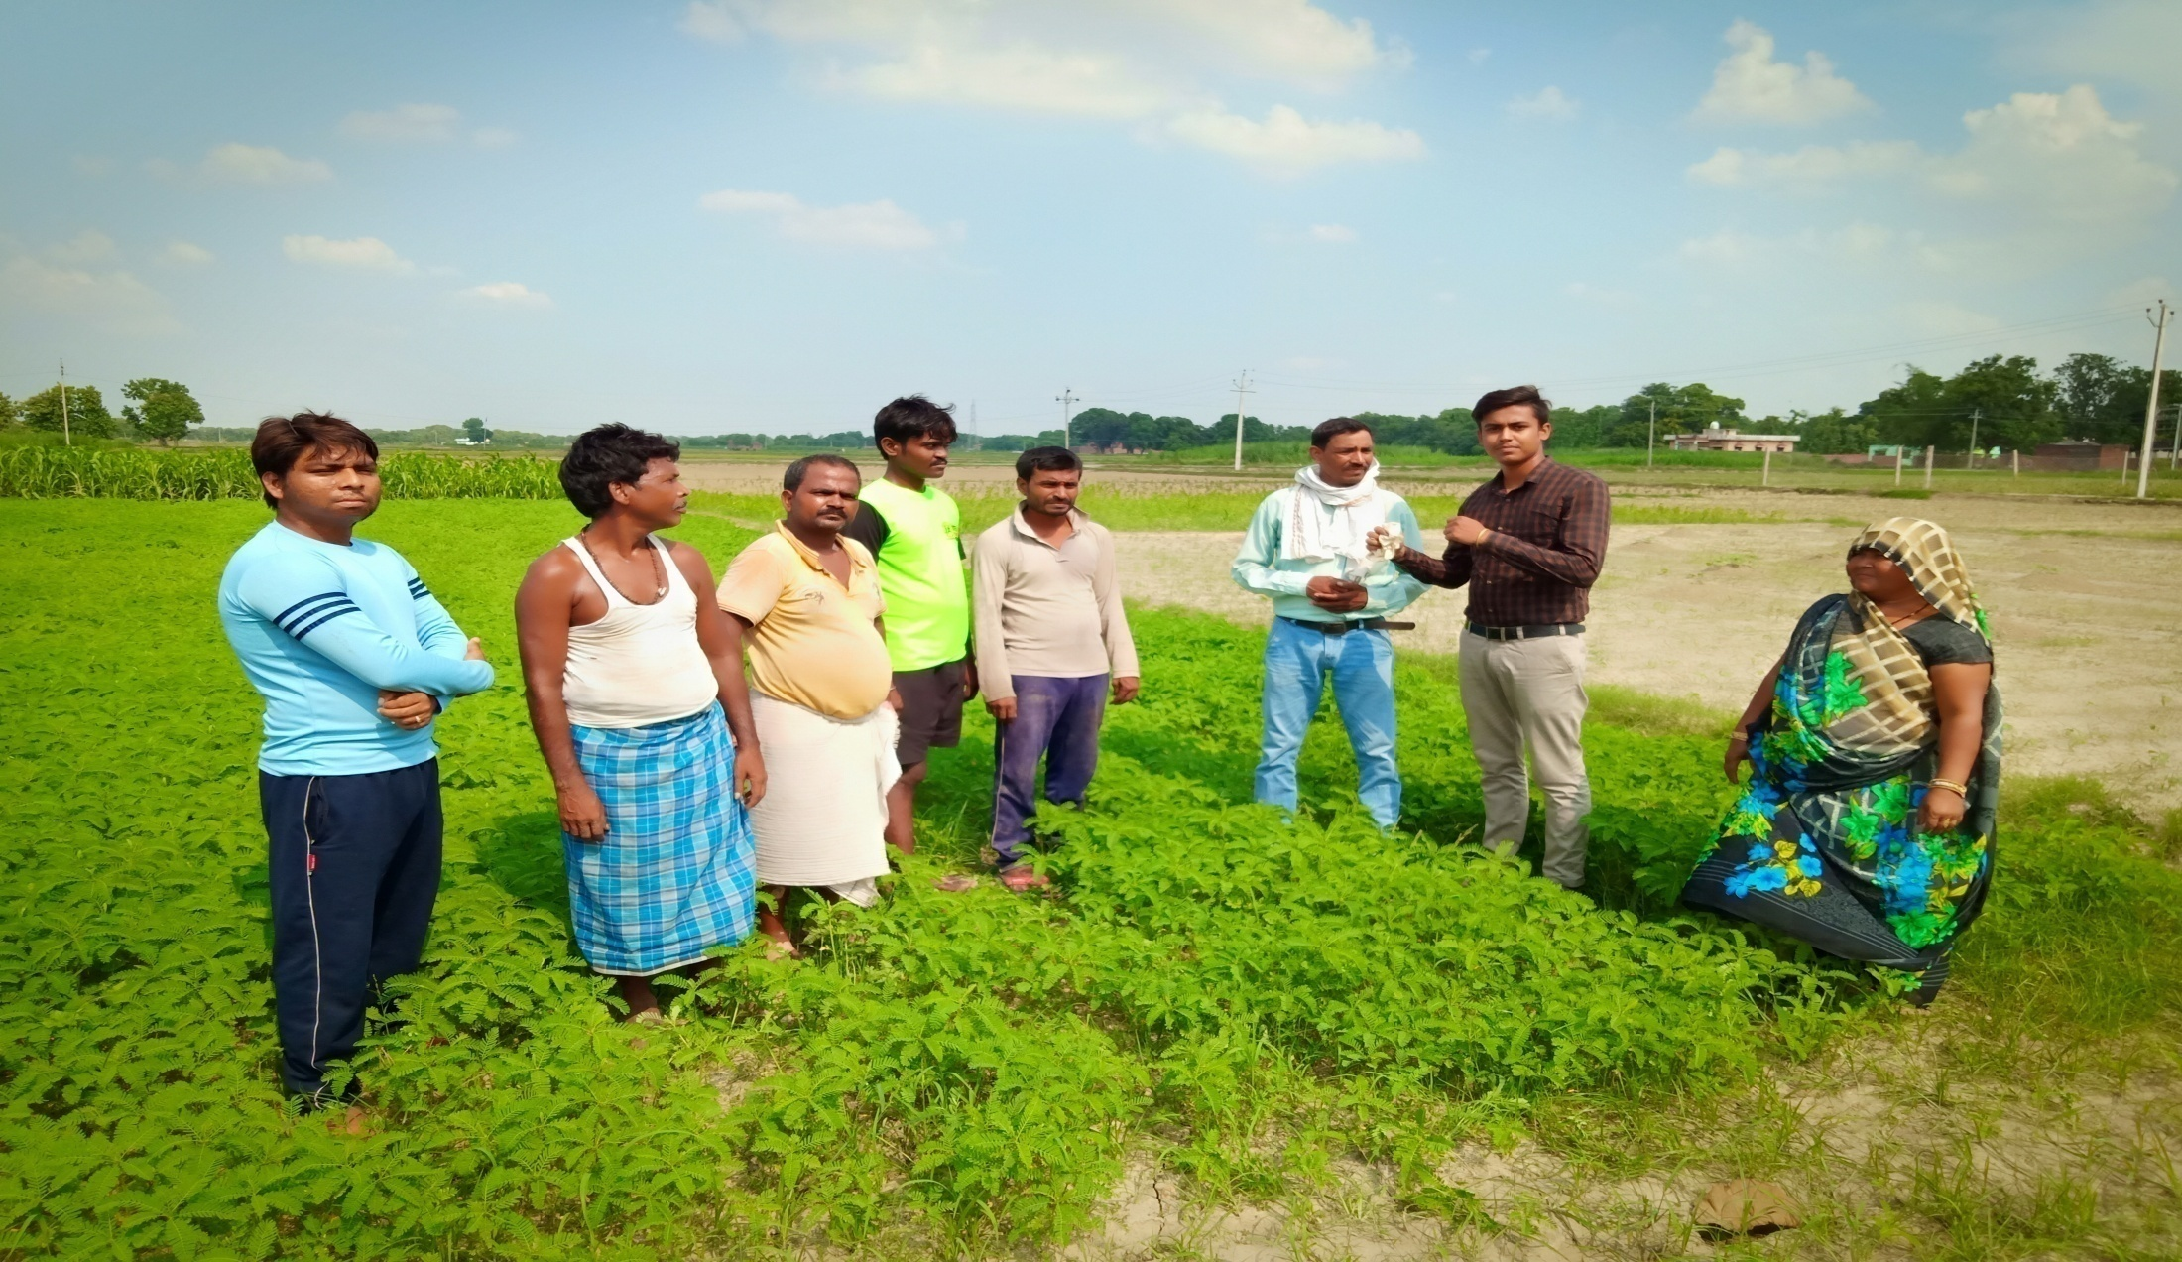
Awareness about modern farming method.

Slide 15
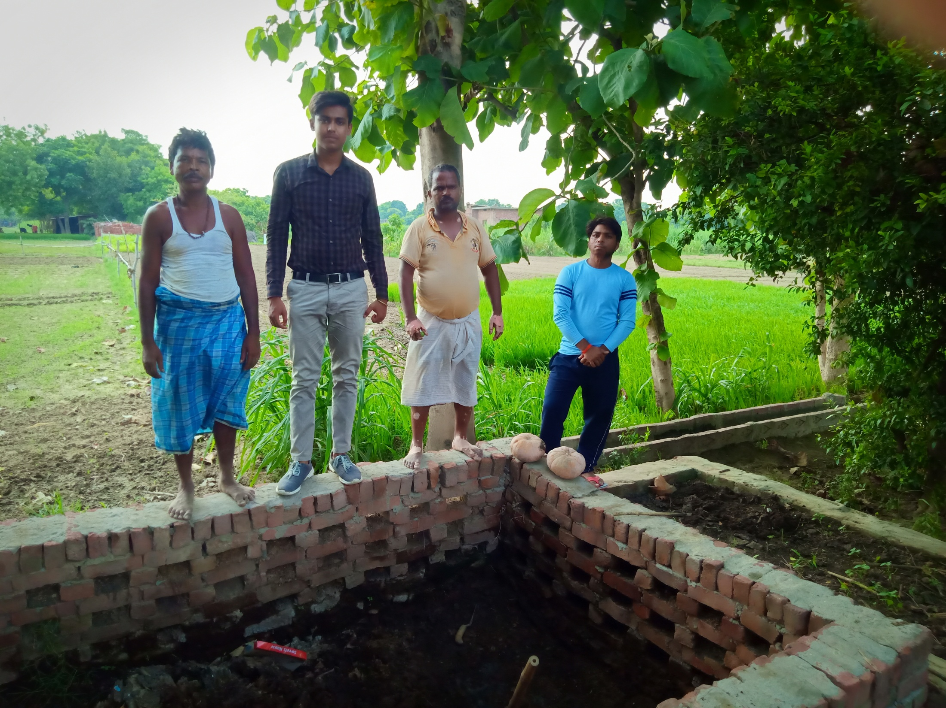

Slide 16
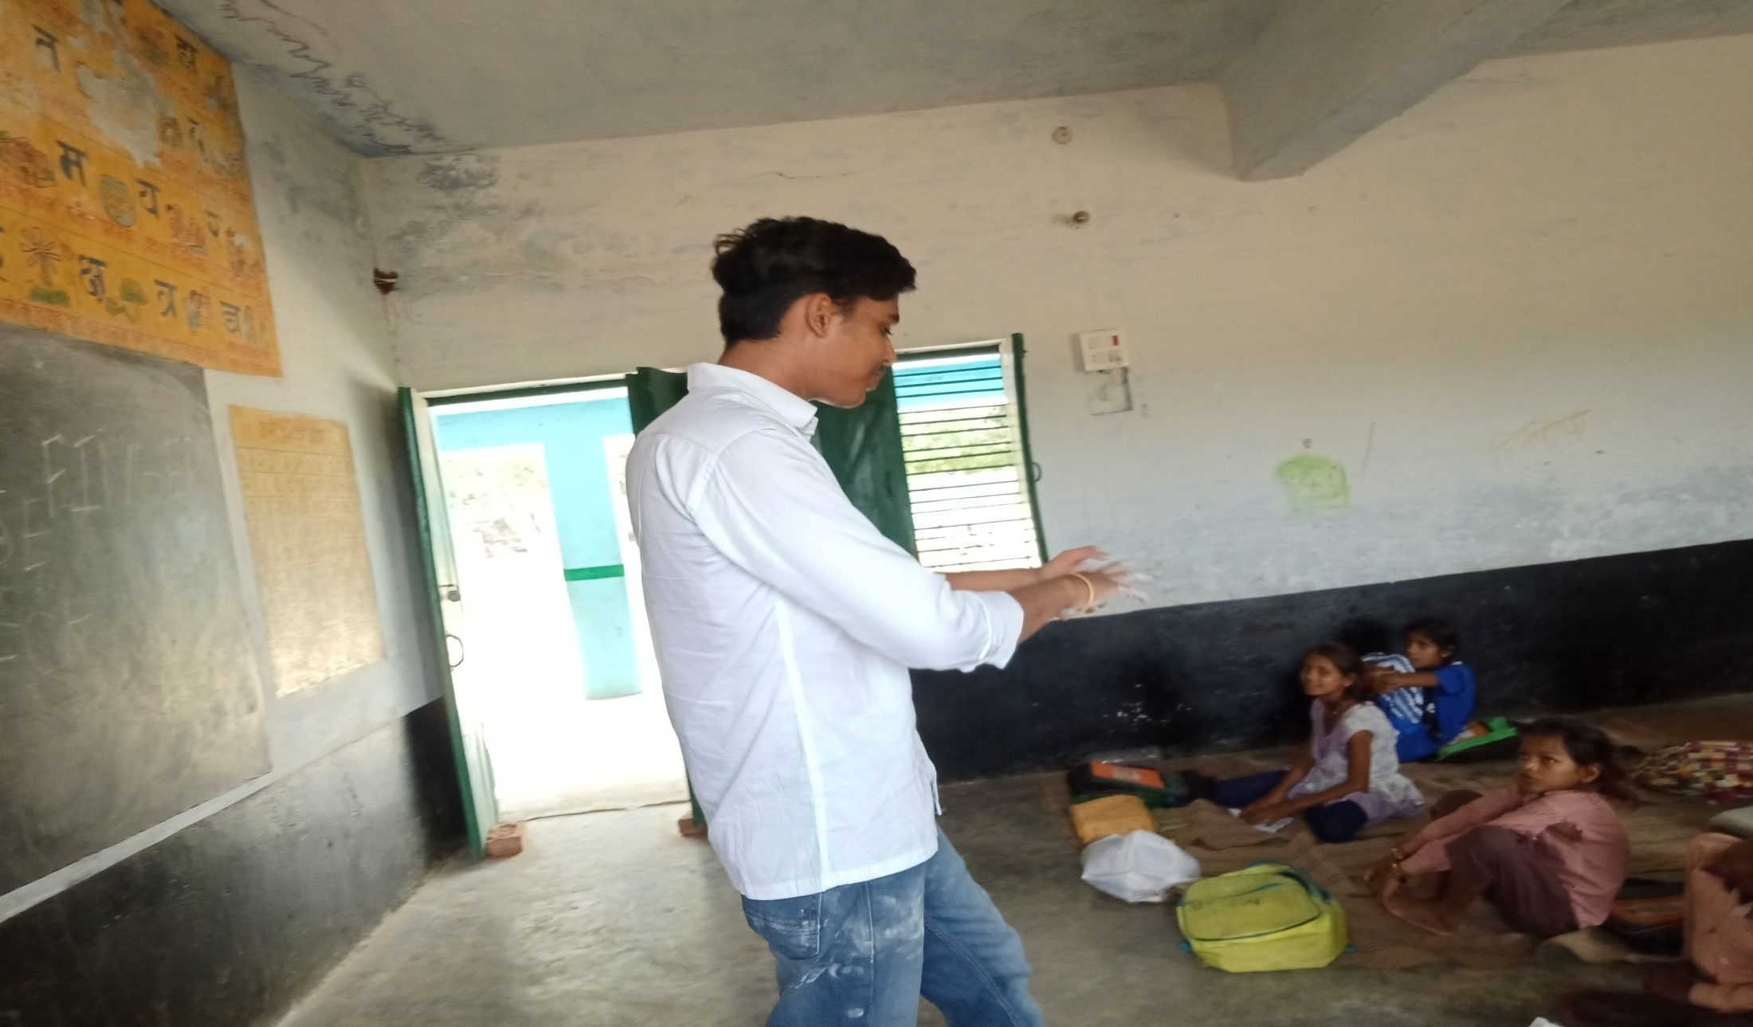
Educating to poor children

Slide 17
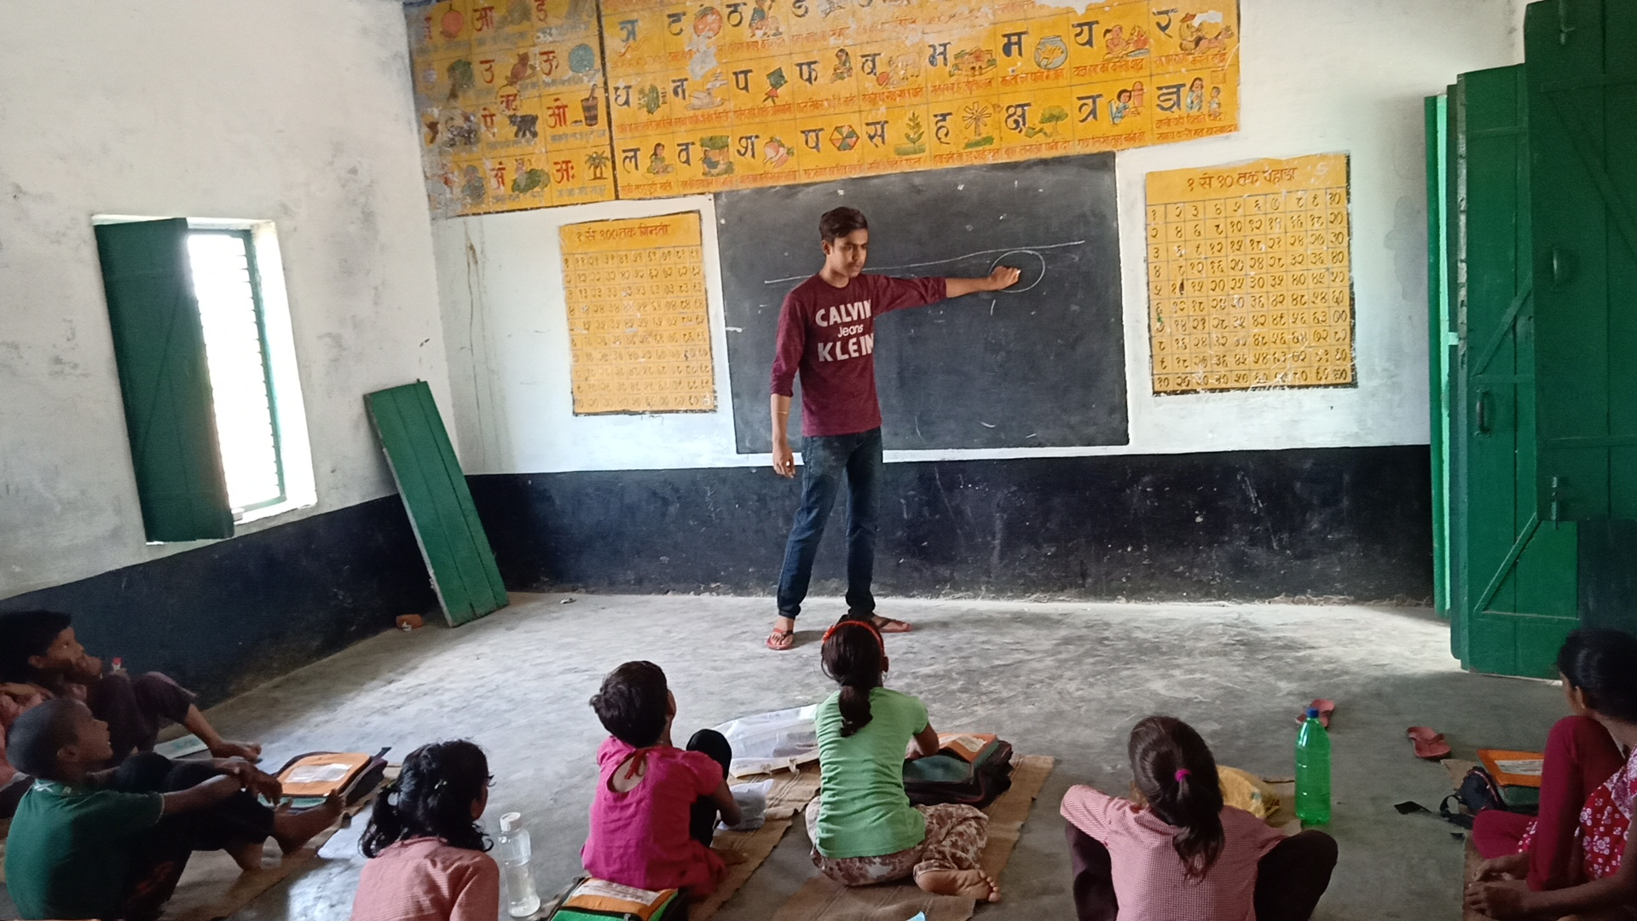

Slide 18
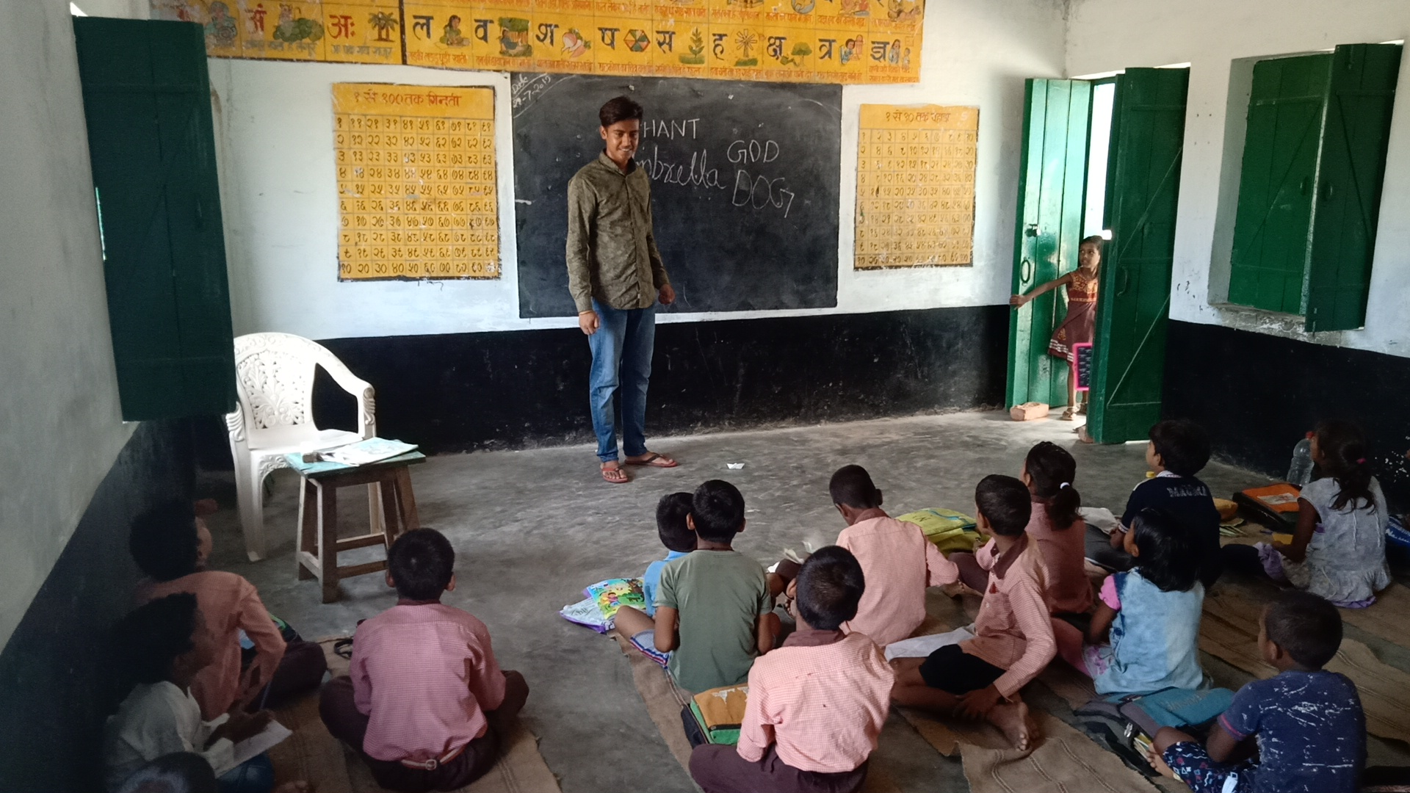

Slide 19
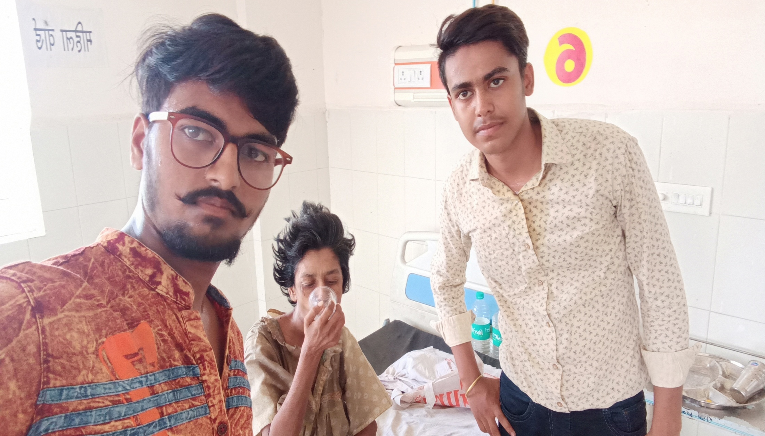
Donating clothes and Serving food

Slide 21


